Slide 1


CHAPTER 3
Scientific Data
and Workflows
The Data Challenge in Science
Data Quality
FAIR Principles
Augmentation
AI Workflows
J. Paul Liu, 2026. Generative AI For Science. Leanpub, https://leanpub.com/generativeaiforscience

Slide 2
Scientific Data: Unique Challenges
AI effectiveness depends critically on data. Scientific data differs fundamentally from web-scale datasets:
General AI Data
Scientific Data
Billions of examples
Hundreds to thousands
Clean, standardized
Noisy, heterogeneous
General vocabulary
Domain-specific terminology
Static snapshots
Temporal, spatial structure
Public availability
Often proprietary or sensitive
DATA-CENTRIC AI PARADIGM
Systematic engineering of data—improving quality, addressing biases, augmenting limited datasets—often yields greater performance gains than model improvements alone.
J. Paul Liu, 2026. Generative AI For Science. Leanpub, https://leanpub.com/generativeaiforscience

Slide 3

PART I
Five Key Challenges of Scientific Data
1
Small Data
4
Temporal and Spatial Structure
100-1000 samples vs. millions. Risk: overfitting, poor generalization
Time series, gridded data, multi-scale dependencies
2
Noisy and Heterogeneous
5
High Dimensionality
Measurement error, missing values, outliers, batch effects
20,000+ genes, megapixel images. Curse of dimensionality
3
Domain-Specific Vocabularies
KEY SOLUTIONS
SMILES, gene ontology, medical codes. LLMs often hallucinate
Transfer Learning
Augmentation
Robust Loss
PINNs
Active Learning
J. Paul Liu, 2026. Generative AI For Science. Leanpub, https://leanpub.com/generativeaiforscience

Slide 4



HANDLING NOISY DATA
Robust Loss Functions
Scientific data often contains outliers from measurement errors, equipment malfunctions, or rare events. Standard MSE loss is highly sensitive to these outliers.
Loss Behavior (Figure 3.1)
Loss Function Comparison
MSE
0.5 × e² — Quadratic, sensitive to outliers
MSE
MAE
Huber
Loss value with outliers present
MAE
|e| — Linear, robust but non-smooth at zero
Huber
Quadratic near zero, linear for large errors
Results on Noisy Data with Outliers
MSE Loss:
3.0381
HUBER LOSS (PyTorch)
MAE Loss:
1.3082
def huber_loss(pred, target, delta=1.0):
Huber Loss:
0.8944
error = pred - target
is_small = torch.abs(error) <= delta
return torch.where(is_small,
Key Insight: Huber loss is more robust to outliers than MSE, and smoother than MAE around zero—ideal for scientific data.
0.5*error**2, delta*(abs(error)-0.5*delta))
J. Paul Liu, 2026. Generative AI For Science. Leanpub, https://leanpub.com/generativeaiforscience

Slide 5
Multi-Fidelity Models
Combining cheap simulations with expensive experiments
Low-Fidelity Data
High-Fidelity Data
Cheap, noisy, fast
Accurate, expensive
FIGURE 3.2 RESULTS
1,000 samples
50 samples
Low-Fidelity Only MSE:
0.0705
Multi-Fidelity MSE:
0.0883
MULTI-FIDELITY PIPELINE
1. Train on Low-Fidelity (1000 samples)
↓
SCIENTIFIC APPLICATIONS
Fast simulations + expensive experiments
2. Predict on High-Fidelity Inputs
Coarse grid → fine grid refinement
↓
Proxy measurements → gold standard
Clinical screening → detailed assays
3. Compute Residual (HF - LF prediction)
↓
Key Benefit: Leverage abundant cheap data while correcting with sparse accurate measurements—maximizing information from limited experimental budgets.
4. Train Residual Model → Final Prediction
J. Paul Liu, 2026. Generative AI For Science. Leanpub, https://leanpub.com/generativeaiforscience

Slide 6
DATA PREPARATION
Data Normalization Strategies
Method
Formula
When to Use
Min-Max
(x - min) / (max - min)
Bounded range needed [0,1]
Z-Score
(x - μ) / σ
Gaussian-ish distributions
Robust
(x - median) / IQR
Many outliers present
Log Transform
log(x + ε)
Heavy-tailed, skewed data
Normal Distribution
Skewed + Outliers
Heavy-Tailed
All methods work similarly well
Robust scaling is most effective!
Log transform first, then scale
Critical: Fit scaler on training data only, then transform validation/test. Save scaler parameters for inference!
J. Paul Liu, 2026. Generative AI For Science. Leanpub, https://leanpub.com/generativeaiforscience

Slide 7
Data Splitting Strategies
Avoiding data leakage in scientific applications
1
Random Splitting
3
Stratified Splitting
Standard 70/15/15 train/val/test
Maintain class balance across splits
Use when: i.i.d. data, no structure
Use when: imbalanced classes
2
Time-Series Splitting
4
Spatial Splitting
Never use future to predict past!
Avoid spatial autocorrelation bias
Train: before date | Test: after date
Test on geographically separate regions
FIGURE 3.6: TIME-SERIES CROSS-VALIDATION
Training Data
Test
← Past | Split Date | Future →
J. Paul Liu, 2026. Generative AI For Science. Leanpub, https://leanpub.com/generativeaiforscience

Slide 8
Data Augmentation for Science
Creating variations while preserving scientific validity
Molecular Data
Drug discovery, materials science
Image Data (Figure 3.8)
3D conformer generation
Microscopy, medical imaging, satellite
SMILES enumeration
Substructure substitution
Rotation
Flip H/V
Brightness
Contrast
Blur
Crop
Synthetic Data Generation
Time Series (Figure 3.9)
Market: $0.29B (2023) → $3.79B (2032)
Sensor data, climate, financial
GANs
VAEs
Diffusion
LLMs
Jittering
Scaling
Time Warp
Window Slice
60% of AI projects use synthetic data (2024)
Caution: Augmentations must preserve scientific validity! Rotation may not be valid for oriented structures.
J. Paul Liu, 2026. Generative AI For Science. Leanpub, https://leanpub.com/generativeaiforscience

Slide 9
HIGH DIMENSIONALITY
Dimensionality Reduction
Scientific data is often high-dimensional: 20,000+ genes, megapixel images, millions of grid cells.
FIGURE 3.3-3.4: METHOD COMPARISON
Method
Type
Use Case
PCA
t-SNE
UMAP
PCA
Linear
Baseline, interpretable
t-SNE
Non-linear
Visualization only
📊
🔵🟢🟣
🔵🟢🟣
UMAP
Non-linear
Viz + clustering
Autoencoder
Neural
Learned representations
Global structure
Local clusters
Local + global
PCA EXAMPLE: 20,000 genes → 50 components
Key Insight: PCA for variance structure, t-SNE for local clusters, UMAP balances both. Each reveals different aspects of data geometry.
pca = PCA(n_components=50)
X_reduced = pca.fit_transform(X_genes)
# ~90% variance explained
J. Paul Liu, 2026. Generative AI For Science. Leanpub, https://leanpub.com/generativeaiforscience

Slide 10
The FAIR Principles
Findable, Accessible, Interoperable, Reusable
SCIENTIFIC DATA FORMATS
F
Findable
DOIs, rich metadata, searchable indexes
HDF5 — General, hierarchical
NetCDF — Climate, CF-compliant
Zarr — Cloud-optimized
FASTQ/BAM — Genomics
CIF/PDB — Structures
A
Accessible
HTTP/APIs, authentication where needed
METADATA STANDARDS
Interoperable
Climate:
CF Conventions, ISO 19115
I
Genomics:
NCBI BioSample, ISA-Tab
Standard formats, clear documentation
Chemistry:
InChI, PubChem
R
Reusable
NIH 2025-2030: FAIR principles are foundational for biomedical research. Data management plans required for NIH-funded research.
Clear licenses, detailed provenance
J. Paul Liu, 2026. Generative AI For Science. Leanpub, https://leanpub.com/generativeaiforscience

Slide 11
PART IV: DATA PREPARATION
The AI-Ready Data Pipeline
Raw Data
↓
Data-Centric AI Paradigm
Quality Control — Remove outliers
Systematic engineering of data—improving quality, addressing biases, augmenting limited datasets—often yields greater performance gains than model improvements alone.
↓
Cleaning — Handle missing values
↓
KEY PRACTICES
Normalization — Scale features
Data quality over quantity
↓
Targeted augmentation for edge cases
Splitting — Train/val/test sets
Iterative refinement from model errors
Domain expert integration
↓
Augmentation — Generate variations
AUTOMATED QC CHECKS
↓
Missing values
Range checks
Duplicates
Outliers (>3σ)
AI-Ready Dataset
J. Paul Liu, 2026. Generative AI For Science. Leanpub, https://leanpub.com/generativeaiforscience

Slide 12
2024-2025 DEVELOPMENT
Autonomous and Self-Driving Labs
EXAMPLE SYSTEMS
Integration of AI planning with robotic execution enables closed-loop experimentation, dramatically accelerating discovery.
A-Lab (Berkeley Lab)
AI proposes compounds, robots synthesize and test
Key Components
Active Learning: AI selects optimal next experiments
CRESt (MIT)
Robotic Execution: Automated sample prep and measurement
Copilot for Real-world Experimental Scientists
Closed-Loop Feedback: Results inform next design
LLM Integration: Natural language human-AI collaboration
BayBE
Open-source Bayesian optimization framework
CLOSED-LOOP EXPERIMENTATION
AI Design
→
Robot Execute
→
Analyze
↺
Impact
Dramatically accelerates materials discovery and optimization through AI-guided experimental design
J. Paul Liu, 2026. Generative AI For Science. Leanpub, https://leanpub.com/generativeaiforscience

Slide 13
Reproducibility in AI-Enhanced Research
TOOLS FOR REPRODUCIBILITY
REPRODUCIBILITY CHECKLIST
DVC
MLflow
✓
Random seeds set and documented
Data version control
ML lifecycle tracking
✓
Software versions recorded
✓
Data sources cited with DOIs
Snakemake
Nextflow
Workflow management
Containerized pipelines
✓
Processing pipeline version-controlled
✓
Model hyperparameters logged
Docker
YAML Configs
✓
Environment captured (Docker, conda)
Environment capture
Parameter documentation
✓
Code shared in repository
"Good science is reproducible science. Document everything."
J. Paul Liu, 2026. Generative AI For Science. Leanpub, https://leanpub.com/generativeaiforscience

Slide 14
Key Takeaways
1
Start with Data Quality: Clean, well-documented data is the foundation for all AI success
"The goal is to build robust, reproducible AI systems that advance scientific discovery despite the inherent challenges of scientific data."
2
Embrace FAIR: Make data Findable, Accessible, Interoperable, Reusable
3
Think Data-Centric: Invest in data engineering, not just model tuning
CHAPTER COVERAGE
Use Domain Tools: Leverage specialized formats (HDF5, NetCDF, SMILES)
5 Data Challenges
Robust Loss
Multi-Fidelity
Normalization
Splitting
4
Augmentation
Dim. Reduction
FAIR
Autonomous Labs
5
Document Everything: Code, data provenance, processing steps
6
Validate Rigorously: Test on held-out data, check physical consistency
Companion Colab Notebook
7
Automate Workflows: Use AI to generate reproducible pipelines
All code examples available as runnable notebook with complete implementations and visualizations
J. Paul Liu, 2026. Generative AI For Science. Leanpub, https://leanpub.com/generativeaiforscience

Slide 15
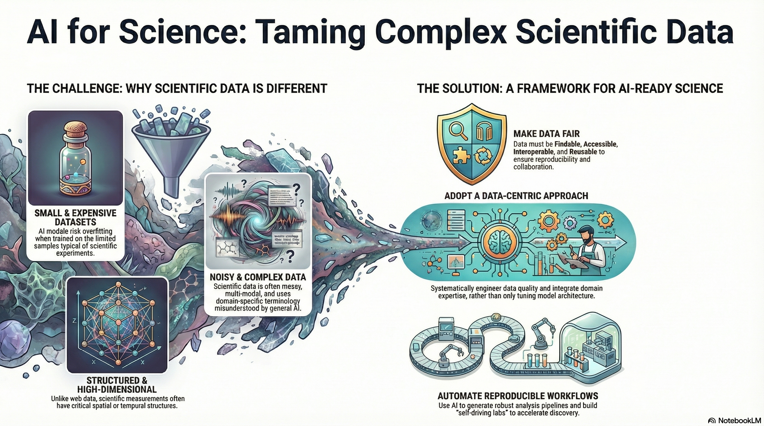
J. Paul Liu, 2026. Generative AI For Science. Leanpub, https://leanpub.com/generativeaiforscience

Slide 16
References and Further Reading
DOMAIN-SPECIFIC TOOLS
KEY PAPERS
RDKit — Chemistry
Biopython — Biology
xarray — Climate
SciSpacy — NLP
Wilkinson et al. (Scientific Data 2016)
FAIR Guiding Principles
Full Working Code:
Zha et al. (ACM Computing Surveys 2023)
rewriting.ai/bookcode/ai4sci.php
Data-centric AI: A Survey
Abolhasani and Kumacheva (Nature Synthesis 2023)
Book Information
Self-driving labs in chemical sciences
J. Paul Liu, 2026
Generative AI For Science
Leanpub
Raissi et al. (JCP 2019)
Physics-informed neural networks
Sandve et al. (PLOS Comp Bio 2013)
Next Chapter
Ten simple rules for reproducible research
Chapter 4 — Text and Knowledge Generation for Scientists
J. Paul Liu, 2026. Generative AI For Science. Leanpub, https://leanpub.com/generativeaiforscience

